Slide 1


Intro to Data Science:
CRISP-DM

Slide 2


Profile Slide
Background
Mark
Barbour
Emergency Communications
IT for Banking and Real Estate
Data Science Consulting For Real Estate
Data Science General Consulting
Computer Vision
Photogrammetry
Security
System Evaluation
DS Instructor Flatiron School
Connect: li.foxbatcs.com

Slide 3

Agenda
What is CRISP-DM?
Why is it useful?
Parts of the Process
Live Coded Example
Q&A

Slide 4

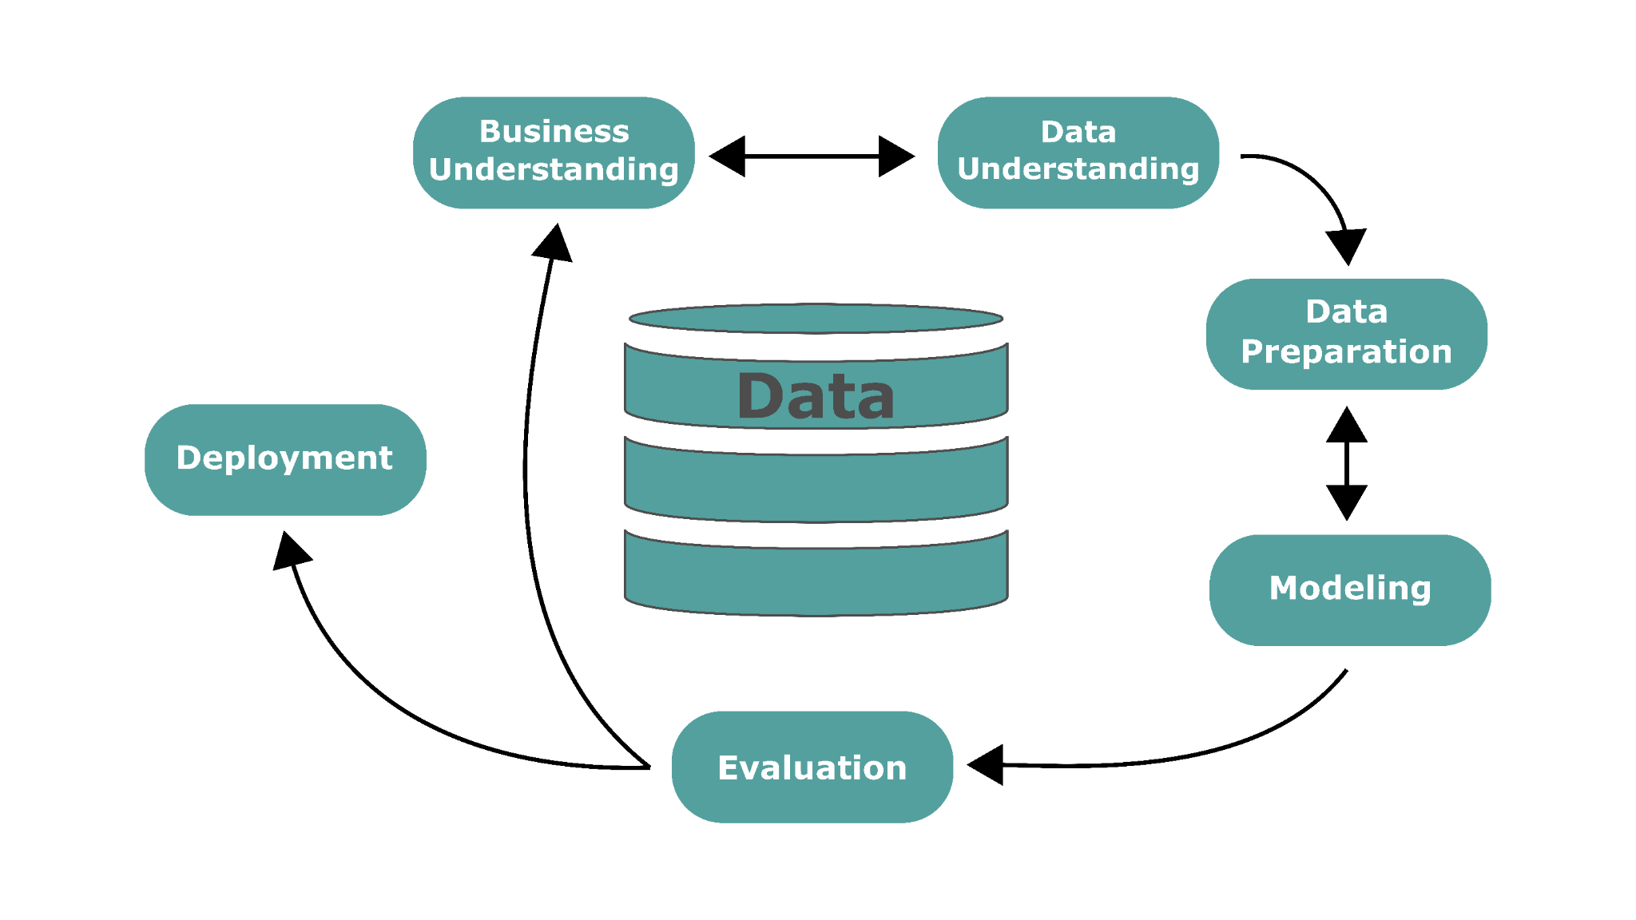

What is CRISP-DM?
CRoss Industry Standard Process for Data Mining
Six phase process that describes the data science life-cycle.

Slide 5
Why CRISP-DM?
CRISP-DM is a process that adds structure to Data Science Projects.
Stakeholders have:
Allows data professionals to explore relationships to:
Problems (Costing time, money, stress on labor force, etc)
Desires (For untapped markets, more efficient supply chains, etc)
Find opportunities
Quantify the risk/reward of opportunities
Find potential hazards

Slide 6
Business Understanding
Stand-Ups & 1-on-1 Meetings
Preliminary Data
Developed between Stakeholders, Subject Matter Experts, and Data Professionals.
Refers to all of the relevant information needed by those on the project.
Iterative Process
Frequent Updates
Business Understanding gets refined and updated iteratively with the Data Understanding.
The more your Stakeholders understand what data they have the better questions they ask.
Stakeholders rely on Data and IT Professionals to keep them informed throughout the process.

Slide 7
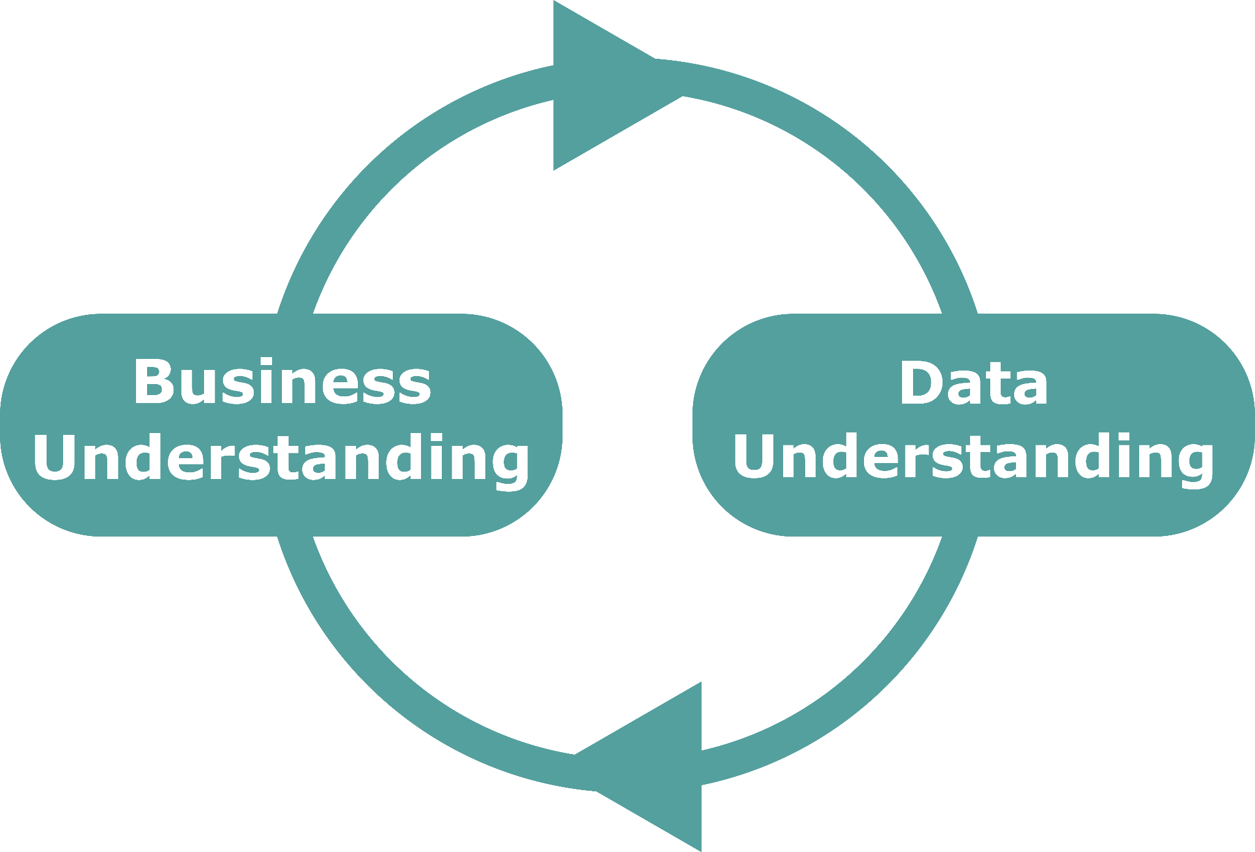
Data Understanding
The Data
Contains
Iterative Process
Inform the questions you ask in your Business Problem
Represent the information relevant to that problem
Features of the data (columns)
Descriptive statistics
Some initial Exploratory Data Analysis (EDA)
Revisit your Business Understanding and update your stakeholders. This could:
Change project goals
Require more data or resources
Refine questions that are asked
Iterate until you have a well defined Business Problem.

Slide 8
Business Problem
Where to start?
What are you trying to do?
What kind of data do you have to work with?
Predict a category?
Find anomalies?
Predict a precise value?
Identify groups or common patterns & trends?
Nominal, Ordinal, Integer, Ratio
Time Series
Multimedia (Audio, Video, Images)

Slide 9
Data Preparation (Fundamentals)
Environment Setup
Useable Data Format
Import Libraries
Computable Data
Jupyter
VSCode
Terminal
Google Colab
Databases
API’s
CSV’s
Spreadsheets
PDF’s/Word
Proprietary Formats
Pandas
Matplotlib
Seaborn
Numpy
Sci-kitLearn
DataFrames
Numpy Arrays
Data Lakes

Slide 10
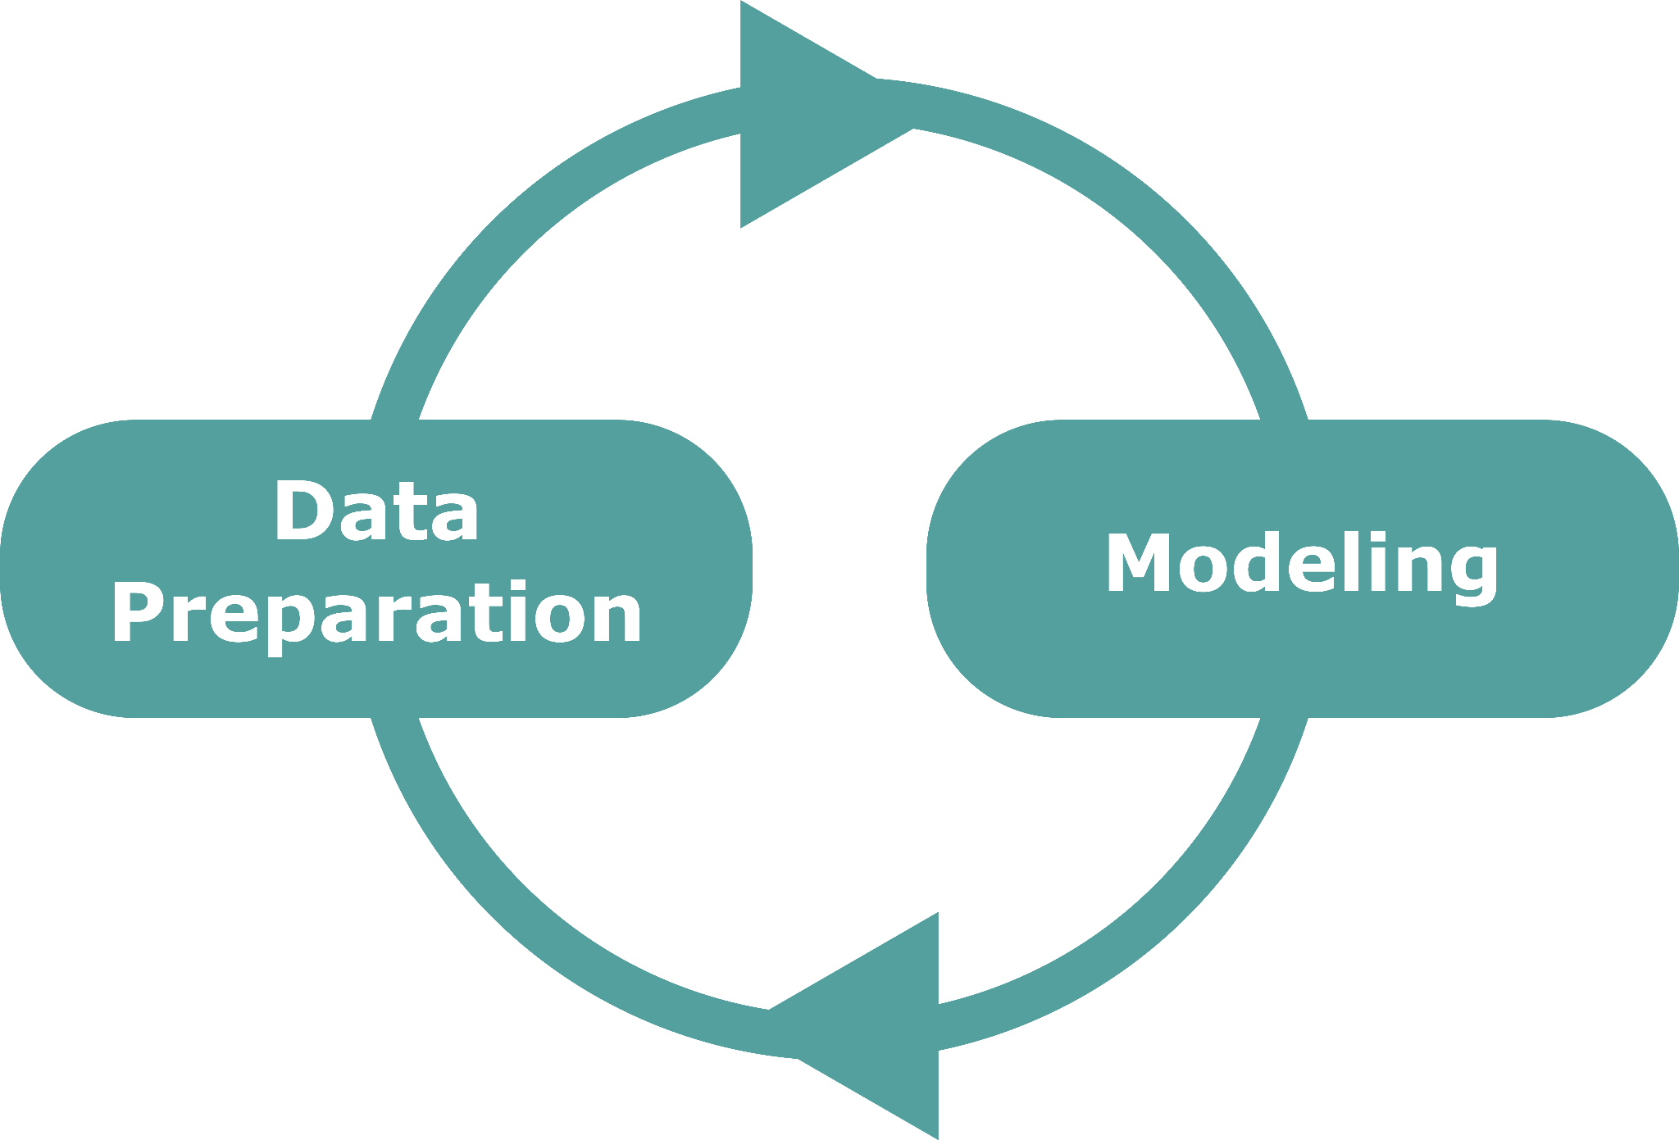
Data Preparation (Exploring)
What needs to be done to the data before you can start to analyze?
LOOK AT THE DATA
Descriptive Statistics
Iterative Process
Yes…stare (⚆_⚆) at your data
Helps prime your brain for patterns
Orients you to better deal with abstractions
Counts of values
Null values, outliers
Central Tendencies
Mean, Median, Mode
Spread
Variance, Std. Dev.
Value Counts
Improves your Business Understanding
Generates good starting questions for you to test and refine

Slide 11

Modeling
Establish a Baseline Model
Analyze the metrics in context of your Business Understanding
Refine any Data Preparation that is needed
Consider some of the flaws of the model and improvements
Compare metrics between multiple models
Iterate until you have some solid recommendations

Slide 12
Initial Metrics
The first model we run will be simple and allow us to set baseline metrics to compare future models.
Explained Variance:
Root Mean Square Error:
R-Squared score
Initial model doesn’t tell us much
For comparing multiple models
Score closer to 1.0 is best
Tells us how “off” our model is
RMSE is in the units of our feature
What if my model is Terrible!?
This is okay!

Slide 13
Iterative Modeling
Run an additional model with an improvement
We’ll start by adding an additional feature
Then evaluate the metrics and make a decision
We might need to do some additional data prep
We might need some additional data
Iterate through this process until you have a practical model
So let’s get into the code…
crisp-dm.fxbt.io

Slide 14
Evaluation
Once we have a couple of strong models, we want to evaluate with data we set aside in our train/test split that the model was not trained on.
This is like keeping the answers to a test from the students who are learning and taking the test, and using those true values to grade how well they did on their provided answers.
After that, we might deploy, or we might go back to our stakeholders to refine the Business and Data Understanding for another iteration.

Slide 15
Deployment
In this case, it will be Conclusions and Next Steps
The “Deployment” for this project might look like a combination of the following:
Generate Reports for Candidate Lots
Deploy a Pricing Model on a cloud service like Google Cloud or AWS
Creating a non-technical presentation for potential investors

Slide 16
Q&A
Connect: li.foxbatcs.com
Notebook: crisp-dm.fxbt.io
Mark Barbour
DS Instructor,
Flatiron School

